Slide 1

FIX FFA ANDROID USER MANUAL
JUL | 2022

Slide 2

Application Installation
Download the application below to install the Fix FFA Android.
URL:

Slide 3
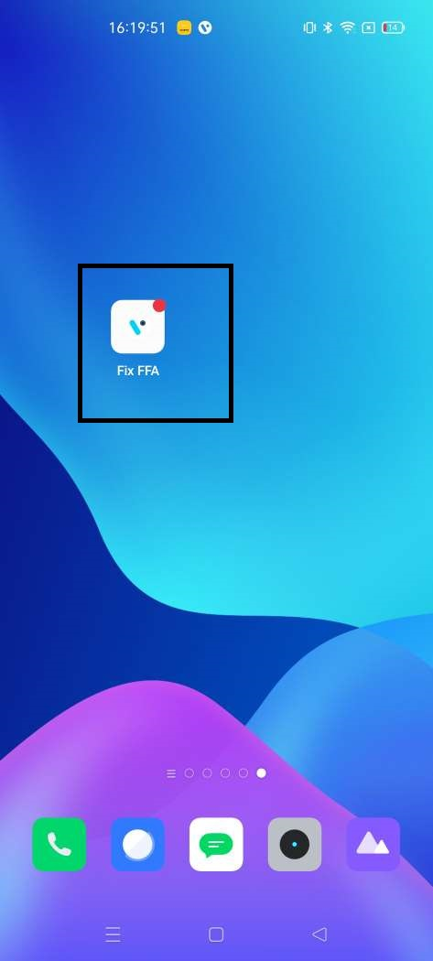
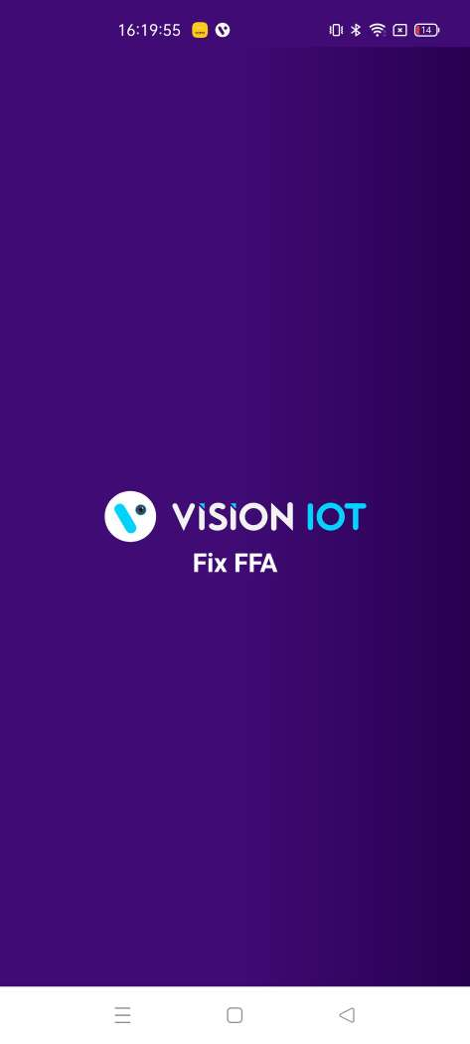
Login
Install App and click on the “Fix FFA” application icon to launch the application.

Slide 4
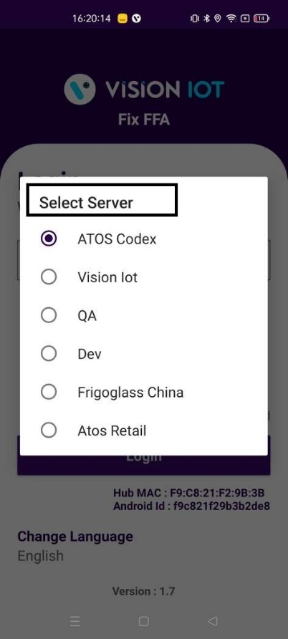
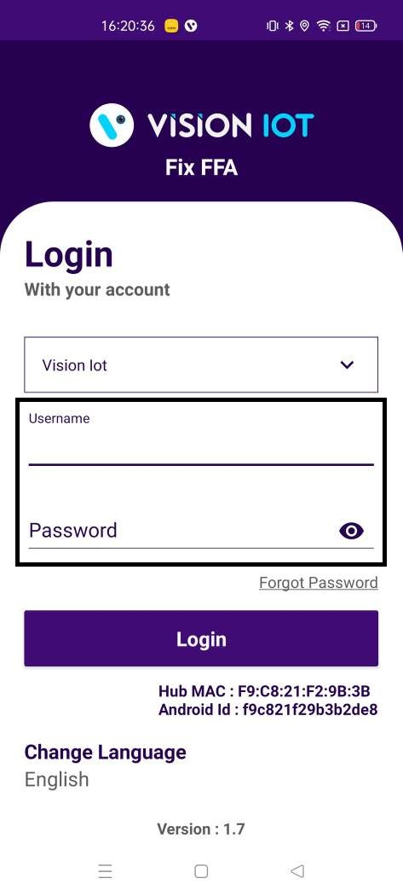
2. If the user logs in the first time, it will ask for Email (User id), Password, and Server. Use valid credentials for login and appropriate server and click on the LOGIN button.
Note: Please ensure Bluetooth & Internet connection (via Mobile Wi-Fi or Mobile Data) must be enabled in the Phone otherwise login will be failed.

Slide 5
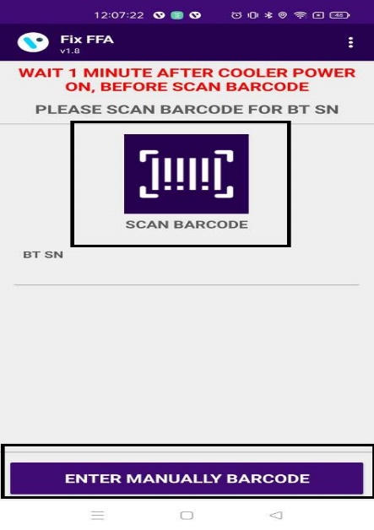
Scanning Screen
User can scan the barcode OR Enter manually for BLE device

Slide 6
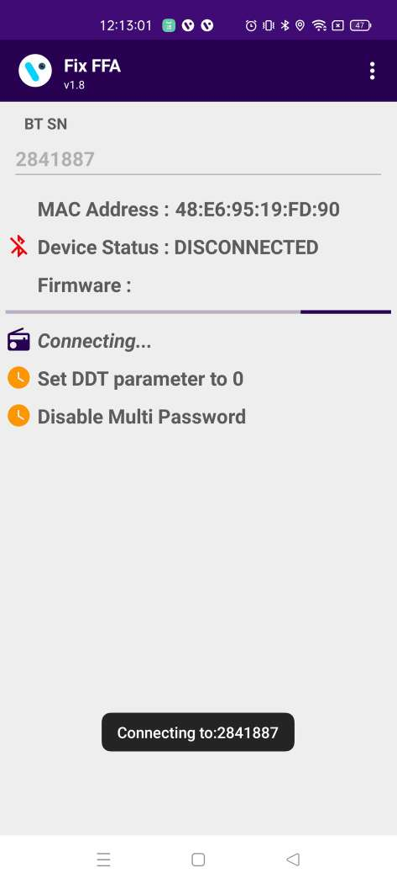
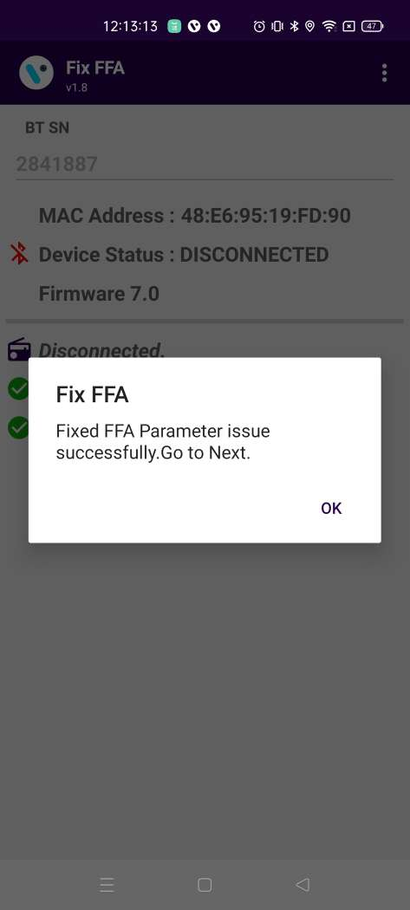
Set DDT Parameters
User can scan the barcode OR Enter manually for BLE device

Slide 7
